Slide 1
基于三维点扩散函数的偏移图像去模糊化方法
论文审稿意见修改及反思
刘策文
2022年12月12日

Slide 2
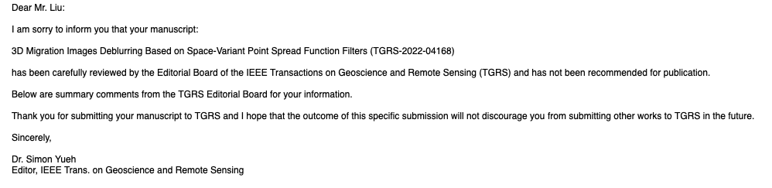



审稿意见返回
结果还不错，应该不会被拒
深受重创
心累，冰冷到极点

Slide 3
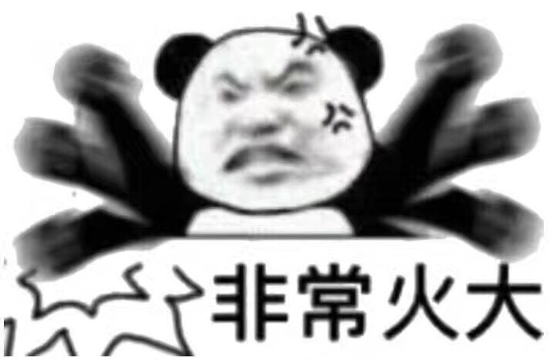
审稿意见返回 -- Reviewer1
The motivation of your work starts from assumptions that are erroneous: first, the PSFs or deblurring approaches are commonly used in the industry in 3D. There are also time/space of FK domains implementations that are exactly the same as the one you outline in your equations 1-6. Second, I have no idea what you mean by the “local-layered medium assumption” in the deblurring filter approach, which seems to be the one thing you want to tackle. All these methods make a (local) stationarity assumption in the computation of their filters or PSFs, and so are you. Some approaches might assume explicitly that the medium is locally layered, but that would have to do with a particular implementation, not really a property shared by all these approaches. The mapping of these local properties to the global image (by inverse distance weighting in your case, or using non-stationary convolution operators by Guitton) is the difficult part. Spreading the PSFs in a 3D cube to handle the non-stationarity is done routinely in the industry for the image-domain LSM approach. You are not proposing anything new here, I fear. -- Reviewer1
I am also not happy with the wording: deblurring is what all these methods do, so I : is the matching filter approach what you call deblurring? have a hard time understanding what the differences are. I completely understand the differences between the PSF approach and the matching filter approach, for instance
On the example side, I think the field data results are not very interesting because we don‘t see the benefits of LSM in any of your panel (higher resolution, better illumination, attenuation of artefacts). My recommendation is to improve on those field data examples if you can, or just don’t show them. A paper is always stronger with good field data examples, so it would be worth your time improving on them.
It is also quite apparent that your deblurring filter implementation could be improved: we can clearly see the footprint of the patches in Figure 11d (Inline>5km) for instance. You should improve on that before submitting a new version of your paper.
One thing you should do is remodeling shots with your improved images and show residuals in the data space: these methods emulate LSM in the data space, so you should see better fit to the observed data. -- Reviewer1
Overall, I think your work could be published as an overview of existing image-domain methods, but certainly not as a new original contribution to this field. I would recommend to use the service of a technical writer fluent in english: the writing is often muddied and hard to understand. Outside help would really improve the readability of your work. -- Reviewer1

Slide 4
审稿意见返回 -- Reviewer2
The authors extend the well-established deblurring PSF filter from 2D to 3D in the least square acoustic RTM cases. This article is well-written and supported with good synthetic and field examples, but other reviewers may question a lack of novelty for this manuscript.
To meet the novelty standard of TGRS, I would encourage the authors to add more innovations rather than a simple extension from 2D to 3D of the image-domain LSM. (大家都有一套自己对于图像域最小二乘方法的理解）
1. Optimize the space distribution of scatter points from the even-spacing distribution to self-adaptive.
As you know, the locations of scatter points are a function of velocity as well as the migration image(first-time). The authors may try denser scatter sampling in the presence of large lateral variations in depth, and a loose sampling in fewer variations. It’s better to design an optimization function for the spatial distribution of scatter points rather than equal spacing.
2. Extend your study into elastic or anisotropy cases.
Acoustic LSRTM has been well-studied for decades. Several researchers also extend the PSF LSM into elastic cases. It will be innovative if the author tries the VTI or TTI cases since the large eps or delta will defocus the PSF function, especially in the large offset or angles.
3. Replot the 3D illustrations via Madagascar
3D drawings from Matlab may be difficult to provide a detailed illustration compared to Madagascar.
4. Please highlight how you accelerate the speed in 3D cases.
I am sure that you can address these questions very well and come back with an outstanding paper. Thanks very much for your efforts in advance!

Slide 5
审稿意见返回 -- Reviewer3
This study propose a 3D space-variant PSF for image domain LSM. Although the authors use both synthetic and field data to demonstrate the effectiveness of the proposed method, substantial changes are needed before further processing.
First of all, the authors purposely did not cite their own paper published in Geophysics with the same stragety for calculating PSF in 2D. This study is indeed a 3D extension of the previous 2D implementation, but the authors did not discuss any new aspect from 2D to 3D. Thus, the novelty of method is not significant.
(很严重的问题）
Second, the authors have a mis-interpretation of the method proposed by Li et al. (2022), Least-Squares Reverse Time Migration in Imaging Domain Based on Global Space-Varying Deconvolution. The method of Li et al. (2022) is not specially 2D, not implemented in time domain deconvolution, nor has a layered assumption. Thus, the comparison in the II.D section is not reasonable. I think the authors are comparing the proposed method with the layered assumption proposed with Hu et al. 1999.This method is already out of date, and the authors did not cite some new progress published in Geophysics. (引用文献的问题）
Third, since the authors are using space-variant PSF, I would like to suggest the authors to use the method to more chanllenge model with large velocity contrast, such as the salt model.
Finally, comparing the method to data domain LSM with only 5 iteration is meaningless, since the authors did not provide any basic accelerating strategy in LSM. In addition, once LSM is implemented, we would expect it iterates enough to converge. Perhaps the authors can find more interesting comparison in the field data example with sufficient LSM iterations with non-ideal migration velocity.

Slide 6


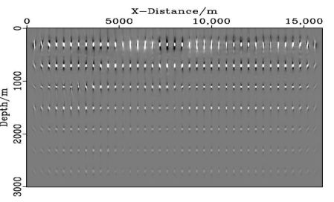
分析总结
总结
已有方法假设PSF是local-stationary（reviewer 1)，我们的方法不存在这样的假设，是针对图像中每一个点都进行处理。
求解反算子的方法有所不同，我们的方法是基于波数域加权最小二乘求取反算子，然后插值，已有方法是通过局部反演，基于已有的3D PSF和偏移图像，直接反演得到局部反射率图像，未描述具体求取细节。 （reviewer 3)
主要问题：创新点不足
需要回答好两个问题：
1）跟已有的图像域LSM方法（大家心里已有的）的区别在哪里？
2）3D跟2D的区别在哪里？（与已发表的2D方法的对比）
1）跟已有的3D图像域LSM方法的区别在哪里？
Li B, Sun M, Xiang C, et al. Least-Squares Reverse Time Migration in Imaging Domain Based on Global Space-Varying Deconvolution[J]. Applied Sciences, 2022, 12(5): 2361.
2）3D跟2D的区别在哪里？（与已发表的2D方法的对比）
方法上与geophysics无差异
生成PSF方面的挑战性，3D问题的复杂性以及重要性层面
总结
1）目前已经将图像域LSM方法做到pixel-wise，从方法层面来讲暂时
没有更好的创新
2）需要注意工业界与学术界的不同。
3）一定要引用自己的文章！！！

Slide 7
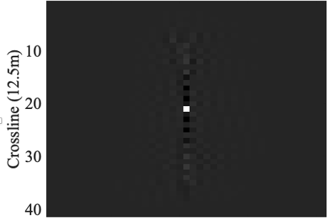

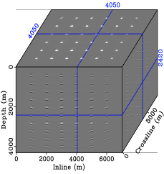
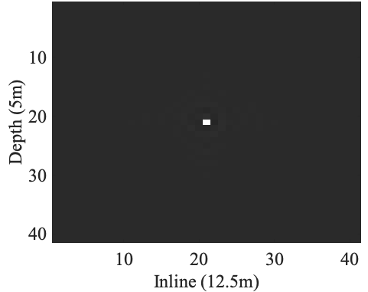
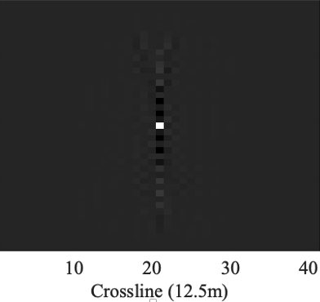
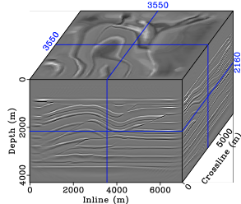
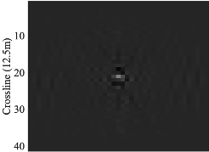
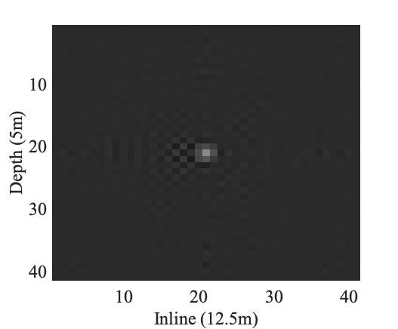
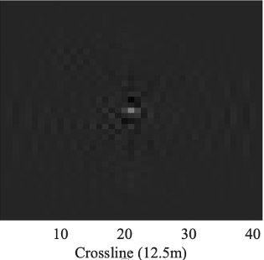
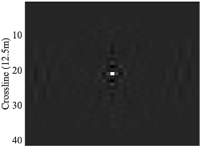

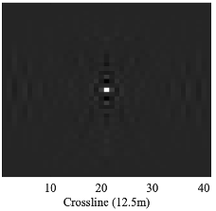
分析总结
注意：审稿人可能并没有很多的耐心去仔细看文章内容以及细节部分
从绘图角度突出本文的创新点
Mode I
*
PSF1
PSF1 Filter
Mode II
C₁
C₁
*
PSF2
Interpolated Filter
*
Mode III

Slide 8
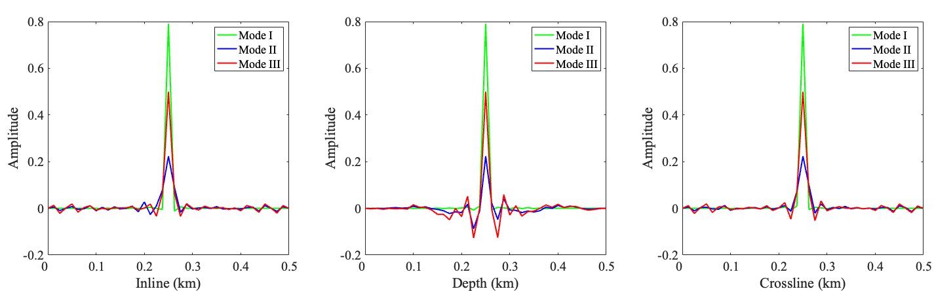
分析总结
从绘图角度突出本文的创新点
我们的方法结合了每一个cube中的其它点的PSF filter信息，而不是每一个cube只用一个反算子，实现了在pixel尺度的去模糊，更加合理且效果更好，插值引入的计算量很少

Slide 9

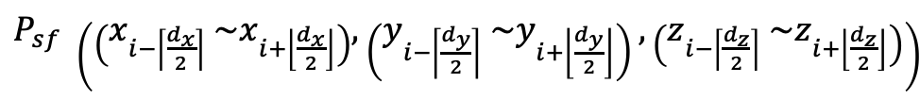






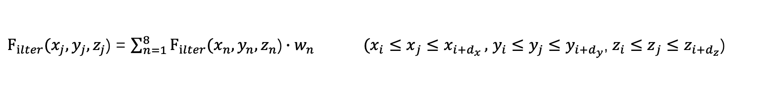

分析总结
从公式角度突出本文的创新点
$I=[c_{1},c_{2},⋯,c_{i},⋯,c_{M−1},c_{M}$] (M>1)
For the cubic $c_{i}$ , the PSF of the center point is
$P_{sf}(x_{i},y_{i},z_{i}$)
Local stationery assumption:
$c_{i}$
$P_{sf} \left(\left(x_{i−\left\lceil \frac{d_{x}}{2}\right\rceil } {\sim x}_{i+\left\lfloor \frac{d_{x}}{2}\right\rfloor }\right),\left(y_{i−\left\lceil \frac{d_{y}}{2}\right\rceil } \sim y_{i+\left\lfloor \frac{d_{y}}{2}\right\rfloor }\right),\left(z_{i−\left\lceil \frac{d_{z}}{2}\right\rceil } \sim z_{i+\left\lfloor \frac{d_{z}}{2}\right\rfloor }\right)\right)$
is constant
$F_{ilter}(x_{i},y_{i},z_{i}$) apply to the entire cubic $c_{i}$
$P_{sf}(x_{i},y_{i},z_{i}$)
$P_{sf}(x_{j},y_{j},z_{j}$)
Local non-stationery (Ours):
$F_{ilter}(x_{j},y_{j},z_{j}$) = $\sum_{n=1}^{8}{F_{ilter}(x_{n},y_{n},z_{n}\text{)}∙w_{n} ({x_{i}≤x}_{j}≤x_{i+d_{x}}},$ ${y_{i}≤y}_{j}≤y_{i+d_{y}}$, ${z_{i}≤z}_{j}≤z_{i+d_{z}}$)
$(x_{j},y_{j},z_{j}$)
Deblurring image point at the position of
$D_{(x_{j},y_{j},z_{j}\text{)} }={center (F}_{ilter}(x_{j},y_{j},z_{j}\text{)} I_{j}$)
*

Slide 10
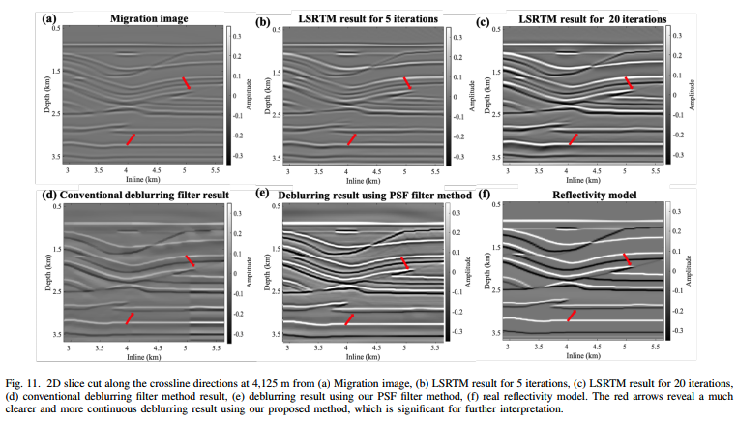
分析总结

Slide 11
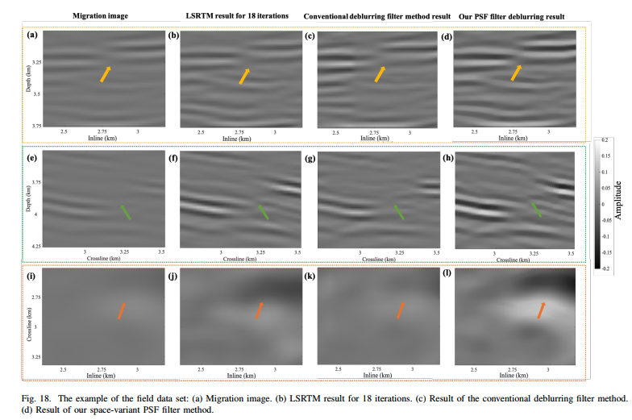
分析总结

Slide 12
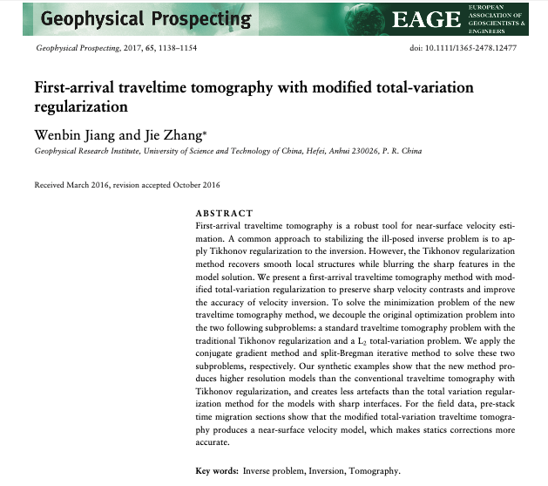
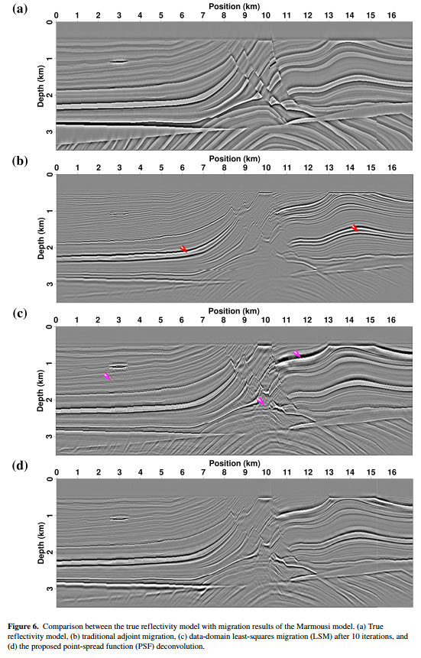
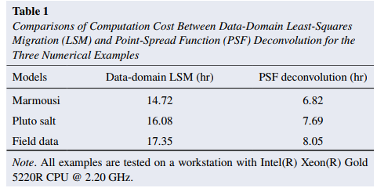

分析总结 -- 基于参考文献
Yang J, Huang J, Zhu H, et al. An Efficient and Stable High‐Resolution Seismic Imaging Method: Point‐Spread Function Deconvolution[J]. Journal of Geophysical Research: Solid Earth, 2022, 127(7): e2021JB023281.

Slide 13
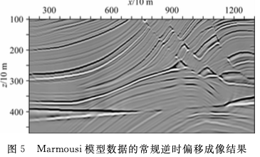
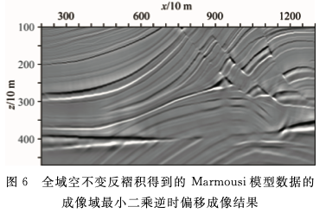
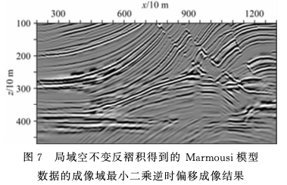
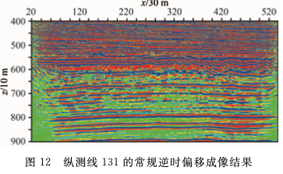
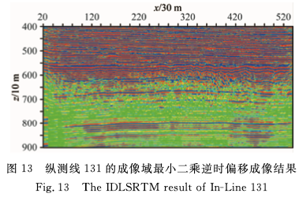
分析总结-- 基于参考文献
陈生昌, 李代光, 金成玫. 高效的成像域最小二乘逆时偏移[J]. 地球物理学报, 2022, 65(8):10.

Slide 14
收获与体会
语言上注意表述是否规范，描述是否恰当得体 “local-layered assumption”
创新点描述不清楚，对目前已有方法的把握了解还不够
检查不够仔细，参考文献引用问题
收获：
1） 针对复杂速度变化较大的岩丘模型问题进行进一步探索 （Reviewer 2 & 3)
写一篇图像域最小二乘偏移方法的综述文章（ Reviewer1）
基于VTI和TTI做进一步的实验探索，进行中……（ Reviewer2）
尝试将PSF去模糊的思想用在其它领域，比如速度反演、波形反演等

Slide 15
反思与总结
没有认真的听取意见，来引用自己的文章，还是抱有一定的侥幸心理。
对一篇文章的创新点把握度还不够，虽然3D方法在理论与实际数据有着较好的效果，但是从方法层面来讲并没有多大的创新，与2D工作以及目前已有3D做PSF反算子方法对比，仅仅只是针对工业界有着较大的意义，对于一篇论文可能审稿人更愿意看到让自己眼前一亮的东西。
文章表述方面存在很多误导性语句，或者描述不太清楚的地方，投稿之时较为匆忙，没有仔细的分析2D与3D 的不同点，没有仔细的展示出我们方法的核心不同点在哪里（通过图的形式，或者说不太直观）？
没有深刻理解工业界与学术界的不同，在开启这个课题之前没有想清楚背后的创新性问题，仅仅只是为了工业界的应用做了很多的工作？

Slide 16
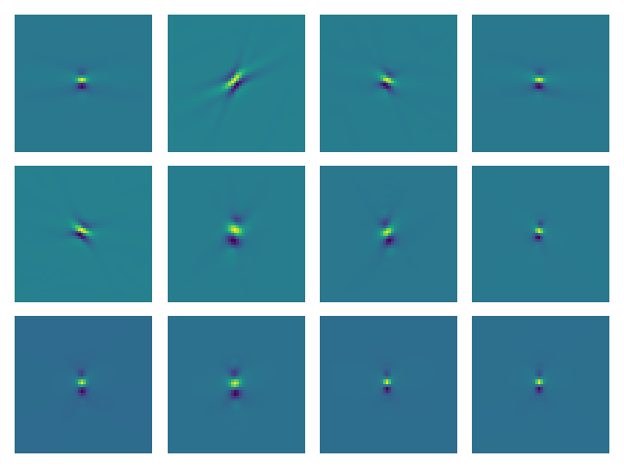
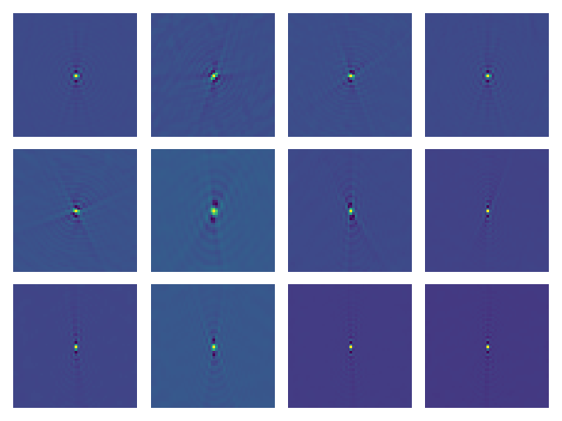
计划与安排
修改论文 （12月11-12月17日） 投Geophysical Prospecting
TTI 实验与撰写论文 （12月18-25日）An Efficient 3D migration images deblurring method for tilted transversely isotropic media 投 Applied Sciences
写完毕业论文第二章节（12月25-1月2日）
Prediction without estimation operator

Slide 17
请大家批评指正！

Slide 18
$F_{ilter}(x_{j},y_{j},z_{j}$) = $F_{ilter}(x_{i},y_{i},z_{i}$)$∙$(1-$\frac{x_{j}−x_{i}}{d_{x}}$) (1-$\frac{y_{j}−y_{i}}{d_{y}}$) (1-$\frac{z_{j}−z_{i}}{d_{z}}$) + $F_{ilter}(x_{i+d},y_{i},z_{i}$)$∙$($\frac{x_{j}−x_{i}}{d_{x}}$) (1-$\frac{y_{j}−y_{i}}{d_{y}}$) (1-$\frac{z_{j}−z_{i}}{d_{z}}$)
+ $F_{ilter}(x_{i},y_{i},z_{i}$)$∙$(1-$\frac{x_{j}−x_{i}}{d_{x}}$) (1-$\frac{y_{j}−y_{i}}{d_{y}}$) (1-$\frac{z_{j}−z_{i}}{d_{z}}$) + $F_{ilter}(x_{i},y_{i},z_{i}$)$∙$(1-$\frac{x_{j}−x_{i}}{d_{x}}$) (1-$\frac{y_{j}−y_{i}}{d_{y}}$) (1-$\frac{z_{j}−z_{i}}{d_{z}}$)

