Slide 1
组会
2022-10-10

Slide 2
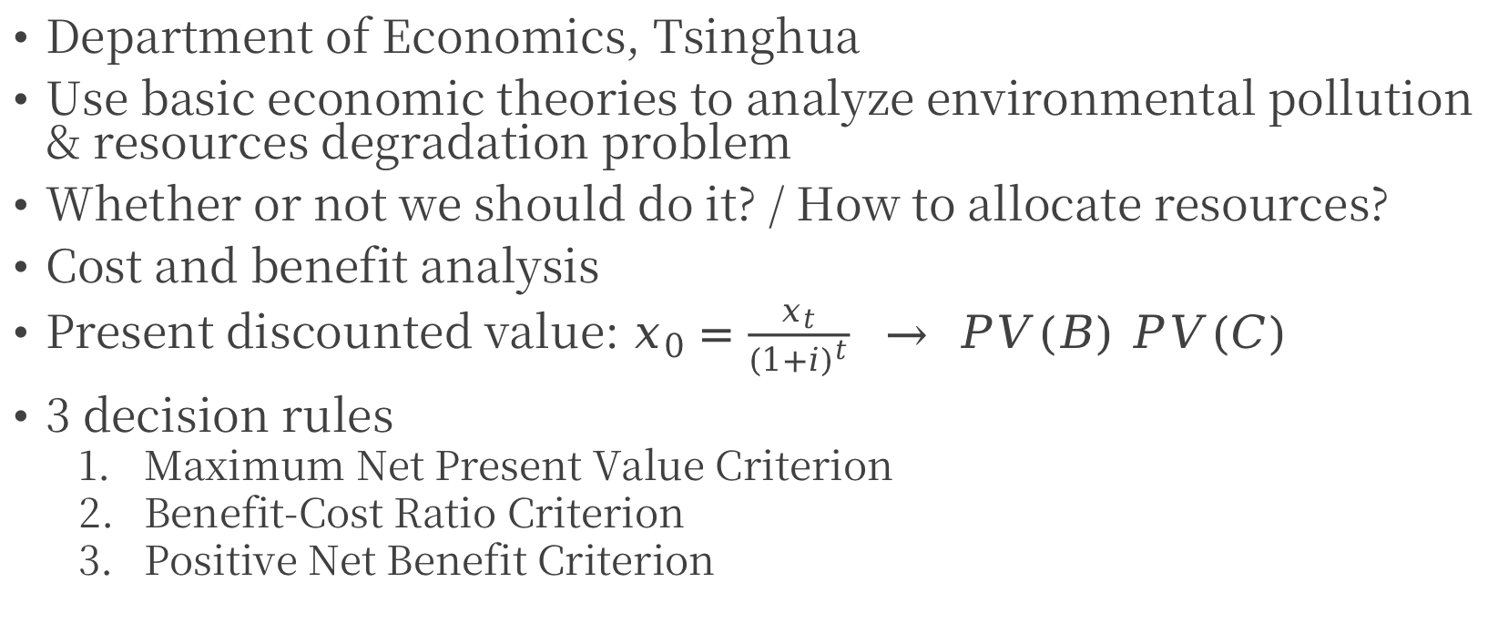
🌍环境与资源经济学
Department of Economics, Tsinghua
Use basic economic theories to analyze environmental pollution & resources degradation problem
Whether or not we should do it? / How to allocate resources?
Cost and benefit analysis
Present discounted value: $x_{0}=\frac{x_{t}}{{(1+i)}^{t}} → PV(B) PV(C)$
3 decision rules
  Maximum Net Present Value Criterion
  Benefit-Cost Ratio Criterion
  Positive Net Benefit Criterion

Slide 3
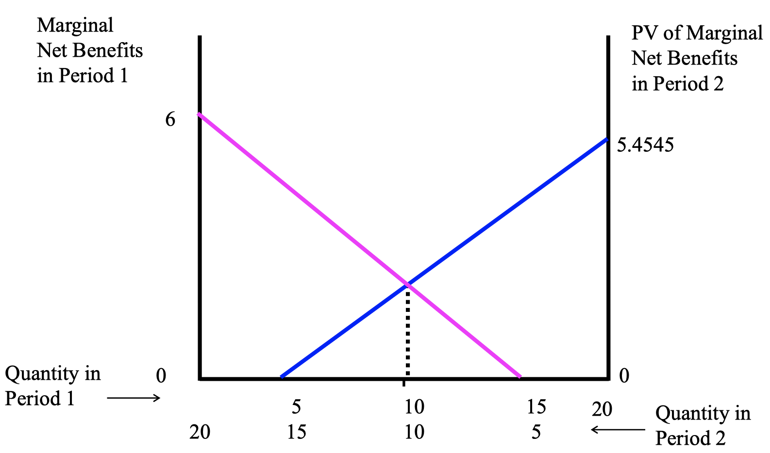
🌍环境与资源经济学

Slide 4
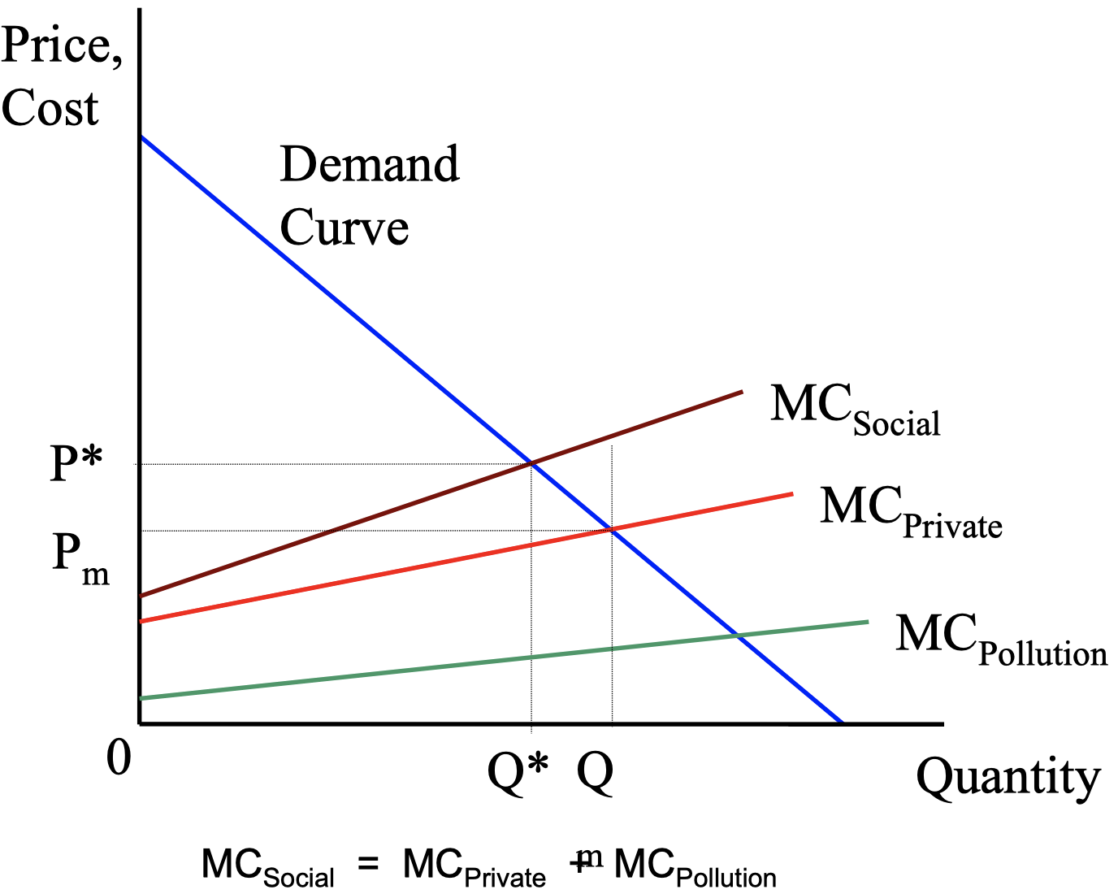
🌍环境与资源经济学

Slide 5
📈Climate Change Uncertainty & Risk
ETH zürich, Institution for Atmospheric and Climate Science
Basics of probabilistic modeling and quantification of uncertainty from global climate change to local impacts of extreme events;
Basics of economic evaluation, economic decision making in the presence of climate risks and pre-emptive risk management to optimally allocate resources

