Slide 1
Image and Video Compression:
1.Auto-Encoder
2.Review
项目：燕山石化部署基本完成 🎊
Earth Data Compression:
FAPEC or CCSDS123.0-B-2
Compressed Sensing:
Divide total sensing image as block & Process them independently
DNN: 4Layers (1Linear + 3 Non-linear)
Cluster:
Boundary-seeking Clustering algorithm using the local Direction Centrality (CDC)
CVPR23

Slide 2
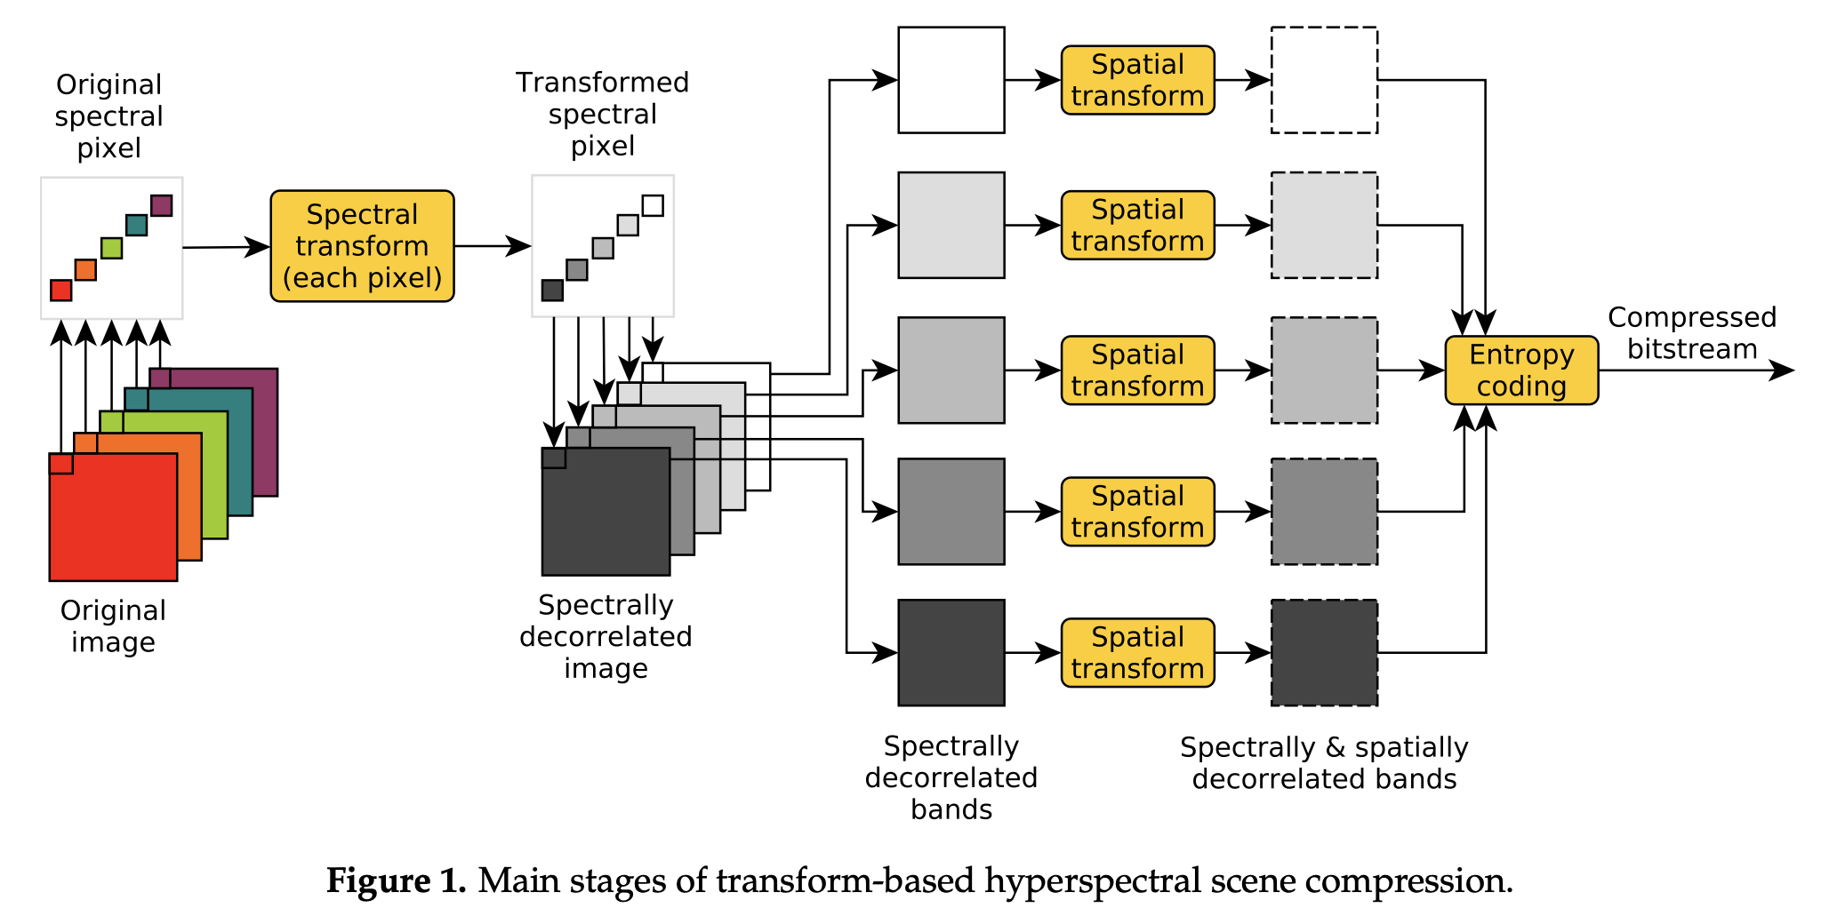
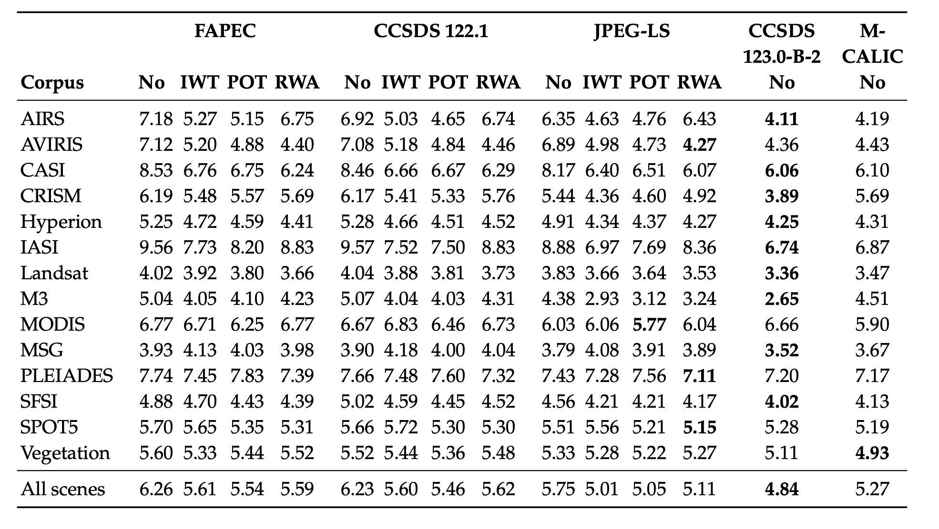
Earth Data Compression:
FAPEC or CCSDS123.0-B-2
Next Week:
1.Implementation: Open-source Code
2.HPC version
3.Combine with some DL Methods?

